Slide 1

Chapter 10
Delivering the
System
Shari L. Pfleeger
Joann M. Atlee
4th Edition
4th Edition

Slide 2
Delivering the System
It is more than just putting the system in place
It is also helping users to understand and feel comfortable with the system
Training
Documentation

Slide 3
10.1 Training Types of People Who Use a System
Users: exercise the main system functions
Operators: perform supplementary functions
create back up copies of data files
define who has access to the system

Slide 4
10.1 Training User and Operators Functions
User Functions | Operator Functions
Manipulating data files | Granting user access
Simulating activities | Granting file access
Analyzing data | Performing backups
Communicating data | Installing new devices
Drawing graphs and charts | Installing new software
 | Recovering damage files

Slide 5
10.1 Training Types of Training
User training
Operator training

Slide 6
10.1 Training User Training
Introduces the primary functions
Record management: record creation, deletion, retrieval, sorting
Navigation thru the system
No need to provide internal mechanism (e.g., sorting algorithms, data structures)
Relates how the functions are performed now, how to perform later with the new system
Need to take into account the difficulty of transition learning

Slide 7
10.1 Training Operator Training
Focuses on support functions and addresses how the system works rather than what the system does
Runs in two levels
how to bring up and run the new system
how to support users

Slide 8
10.1 Training Training Aids
Documents
Formal documentation, manuals
A small percentages of the users read them
Icons and online help
Metaphors (for objects and functions)
Online manuals provide hypertext links
Demonstrations and classes
More individualized, more dynamic; uses of multimedia (hearing, seeing)
Expert users (and trained individuals)
Role models can be convincing

Slide 9
10.1 Training Guidelines for Training
Understand the personal preferences, work styles, and organizational pressures
Need to accommodate different types of participants
individualized system
Divide a training class or demonstration into presentation units with short, limited scope
Determines the type of training based on the location of the participants
Hundreds of students all over? Use web-based training

Slide 10
10.2 Documentation Considering the Audiences
Need to understand the intended audience
Users
Operators
Customer staff
Other member of development team
Design different document for different audience
Include a “gentle” introduction

Slide 11
10.2 Documentation Types of Documentations
User’s manual
Operator’s manual
General system guide
Tutorials and automated overviews
Other documentation: Programmer guide

Slide 12
10.2 Documentation User’s Manuals
Beginning with the general purpose, and progressing to detailed functional description
system’s purpose or objectives
system’s capabilities and functions
system features, characteristics, advantages

Slide 13
10.2 Documentation Operator’s Manuals
Hardware and software configuration
Methods of granting and denying access to a user
Procedures for adding and removing peripherals from system
Techniques for duplicating or backing up files and documents
Notes:
Peripheral devices: printers, mouse etc.

Slide 14
10.2 Documentation General System Guide
The system details in the terms that customer can understand
The system hardware and software configuration
The philosophy behind the system’s construction
Provide cross-referencing

Slide 15
10.2 Documentation Tutorials and Automated System Overviews
Multimedia-based, step-by-step, automated tutorials

Slide 16
10.2 Documentation Other Documentation: Programmer’s Guide
An overview of how the software and hardware are configured
Software components detailed and their functions performed
System support functions
System enhancements

Slide 17
10.2 Documentation User Helps and Troubleshooting
Failure message reference guide
Online help files
Quick reference guide (a quick summary of primary uses, configuration)
Bug Reporting Mechanism

Slide 18
10.2 Documentation Guidelines for Failure Messages
The name of code component executing when the failure occurred
The source code line number in the component that was executing
The failure severity and its impact on the system
The contents of any relevant system memory or data pointers, such as registers or stack pointers
The nature of the failure, or a failure message number (for cross-reference with the failure message reference guide)

Slide 19
Project Management: Effort Estimation

Slide 20
Effort Estimation
Estimating project costs is one of the crucial aspects of project planning and management
Estimating cost has to be done as early as possible during the project life cycle
Type of costs
facilities: hardware, space, furniture, telephone, etc
software tools for designing software
staff (effort): the biggest component of cost
Notes:
S/W cost and effort estimation will never be an exact science
Too many variables
Human
Technical
Environmental
Political

Slide 21
Causes of Inaccurate Estimates
Key causes
Frequent request for change by users
Overlooked tasks
User's lack of understanding of the requirements
Insufficient analysis when developing estimates
Lack of coordination of system development, technical services, operations, data administration, and other functions during development
Lack of an adequate method or guidelines for estimating
Project team's experience with the application, the programming language, and hardware
Capabilities of the project team members

Slide 22
Software Project Estimation
Options for estimation
Delay estimation until late in the project
Attractive, but not practical
Base estimates on similar projects that have already been completed
Unfortunately, past experience has not always been a good indicator of future results
Use relatively simple decomposition techniques to generate project cost and effort estimates
“Divide and conquer” approach
Use one or more empirical models for software cost and effort estimation
Can be used as a cross-check for the previous option and vice versa

Slide 23
Effort Estimation COCOMO model
Introduced by Boehm
Three different models that reflect the complexity
Basis Model
Intermediate Model
Detailed Model

Slide 24
The Development Modes: Project Characteristics
Organic Mode
Relatively small, simple projects
Small teams with application experience work to a set of less rigid requirements.
Similar to the previously developed projects
Relatively small and require little innovation
Semidetached Mode:
Intermediate (in size and complexity) projects in which teams with mixed experience levels must meet a mix of rigid and less than rigid requirements
Embedded Mode
Software projects that must be developed within a set of tight hardware, software, and operational constraints.

Slide 25
COCOMO: Some Assumptions
Primary cost driver is the number of Lines of codes delivered by the project.
Estimates assume that the project will enjoy good management by both the developer and the customer
Assumes the requirements will not substantially change after the requirements phase.

Slide 26
Basic COCOMO Model: Formula
Effort (E) = a (KLOC)^{b} person_months
Development Time (D) = c x E ^{d} months
P = E/D
E is the effort applied in person months, D is the development time in chronological months, P is the number of people required.
The coefficients a, b, c, and d are constants given in the next slide.

Slide 27
Software Project | a | b | c | d
Organic | 2.4 | 1.05 | 2.5 | 0.38
Semi-Detached | 3 | 1.12 | 2.5 | 0.35
Embedded | 3.6 | 1.2 | 2.5 | 0.32

Slide 28
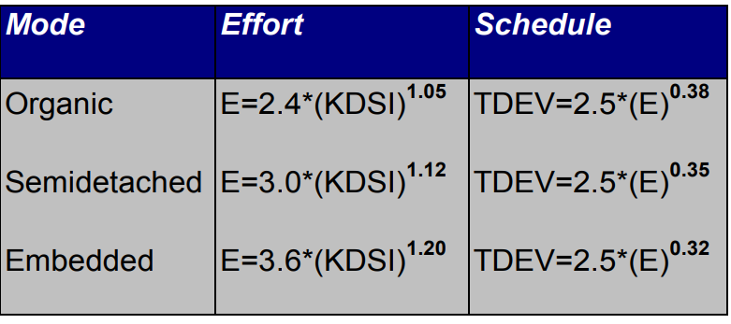
Basic COCOMO Model : Equation
Notes:
KDSI is similar as KLOC. Stands for delivered source instructions.

Slide 29
Example:
Assume the project fits the characteristics of Semi-Detached mode
Assume 32,000 delivered source instructions:
Using the formulas, we can estimate:
Effort = 3 * (32)^1.12 = 146 man months
Schedule = 2.5 * (146)^0.35 = 14 months
Productivity = 32000 / 146 = 219 DSI/MM
Average Staffing = 146/14 = 11 (round off to nearest number)

Slide 30
Introduction to Function Points
Can be used effectively as a means for measuring the functionality delivered by a system
Using historical data, function points can be used to
Estimate the cost or effort required to design, code, and test the software
Predict the number of errors that will be encountered during testing
Forecast the number of components and/or the number of projected source code lines in the implemented system
Derived using an empirical relationship based on
Countable (direct) measures of the software’s information domain
Assessments of the software’s complexity
FP = count total * [0.65 + 0.01 * sum(F_{i})]
Notes:
Count total = unadjusted function points.

Slide 31
Function Point Analysis
Working from the project design specifications, the following system functions are measured (counted):
Inputs
Outputs
Files
Inquiry
Interfaces
Value Adjustment Factors (VAF)
14 Factors
Notes:
Files: group of logically related data or control information maintained within the boundary of the application
Interfaces: group of logically related data or control information referenced by the application, but maintained within the boundary of another application
Inquiry: process made up of an input-output combination that results in data retrieval

Slide 32
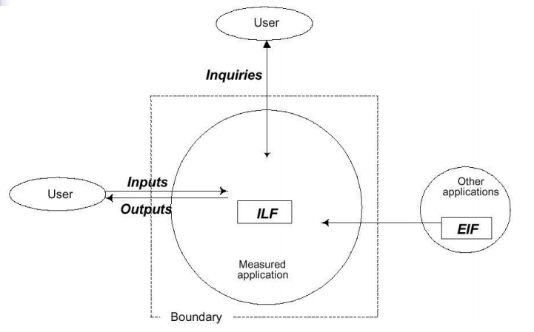

Slide 33
These function points counts are then weighed (multiplied) by their degree of complexity:
Weighting factors are as follows:
Component | Simple (Low complexity) | Average | Complex (High complexity)
Inputs | 3 | 4 | 6
Inquiries | 4 | 5 | 7
Files | 3 | 4 | 6
Interface Files | 7 | 10 | 15
Outputs | 5 | 7 | 10

Slide 34
Function Point Analysis
Identify/collect the information domain values
Complete the table shown below to get the count total
Associate a weighting factor (i.e., complexity value) with each count based on criteria established by the software development organization
Evaluate and sum up the adjustment factors (see example in the next few slides)
“F_{i}” refers to 14 value adjustment factors, with each ranging in value from 0 (not important) to 5 (absolutely essential)
Compute the number of function points (FP) FP = count total * [0.65 + 0.01 * sum(F_{i})]

Slide 35
Function Point Example
Information Weighting Factor
Domain Value Count Simple Average Complex
External Inputs 3 x 3 4 6 = 9
External Outputs 2 x 4 5 7 = 8
External Inquiries 2 x 3 4 6 = 6
Internal Logical Files 1 x 7 10 15 = 7
External Interface Files 4 x 5 7 10 = 20 Count total 50
FP = count total * [0.65 + 0.01 * sum(F_{i})]

Slide 36
Value Added Factors
The following are some examples of these factors:
Is high performance critical?
Is the internal processing complex?
Is the system to be used in multiple sites and/or by multiple organizations?
Is the code designed to be reusable?
Is the processing to be distributed?
and so forth . . .

Slide 37
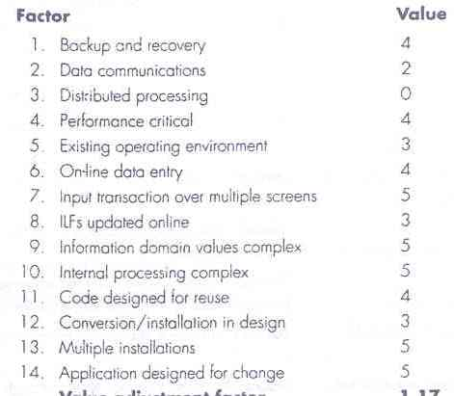
An Example of FP-Based Estimation
Value Adjustment Factors

Slide 38
FP_{estimated} = count_total × [0.65 + 0.01 × Σ (F_{i})]
F_{i} (i = 1 to 14 are value adjustment factors)
So,
FP_{estimated} = W = 50 × [0.65 + 0.01 × 52] = 58.5 (approx.)
Let,
Average Productivity = X = 6.5 FP/m
Labor rate = Y = $8,000 per month
So,
Cost per FP = Z = Y/X = $1,230 (approx.)
Total estimated project cost = W*Z = $71,955 (approx.)
Estimated effort = W/X = 9 person-months (approx)

Slide 39
Quiz on Wednesday – Section B
A lot of students copied in quiz 5. Caught some while checking
Will be given 0 in quiz 5 + 0 in at least one other quiz.
If a student emails by Wednesday evening that they have cheated or let other student cheat of them → they will get 0 only in quiz 5
Otherwise 0 in at least 2 quizzes.
No need to come to my office. Email is sufficient.
Once the marks are up, no changes will be made.

